Slide 1

Tourism support measures
Martti Kalvik

Slide 2

Promoting Estonia as a travel destination
Promoting Estonia as a travel destination 26,5 MEUR
Finland
Russia
Latvia
Sweden
Norway
Germany
Great Britain
China
Japan
the US

Slide 3
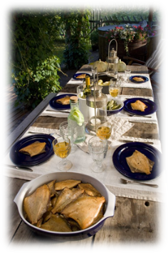
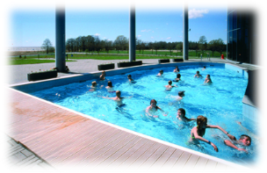
Tourism product development
Focus themes in product development 3 MEUR:
Business and conference
Culture (attraction management, events)
Sport
Food
Nature and sea
Health
Family

Slide 4
Tourism product development
  Support of the introduction of new business models and design of services in order to ensure higher added value and differentiation (6 MEUR).

Slide 5
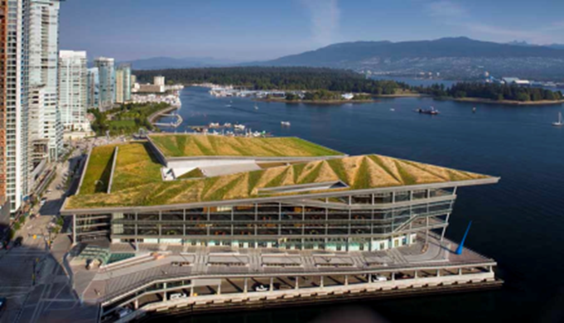

Investments
Development of tourism attractions to create motivation to travel
  Conference centre
  Family attractions
Small harbour
network

Slide 6
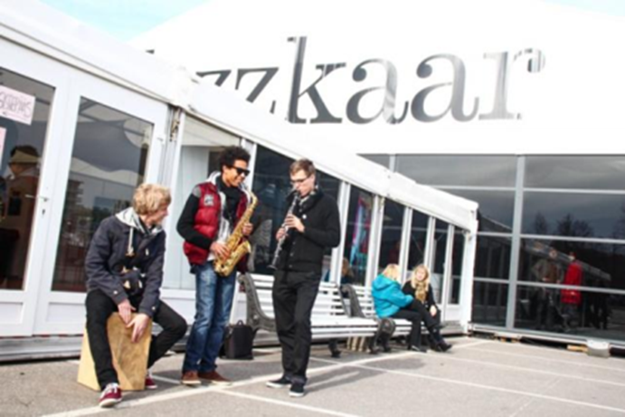
Events (7,4 MEUR)
Events
  Major events
  Cultural and sport events
  International conferences

Slide 7
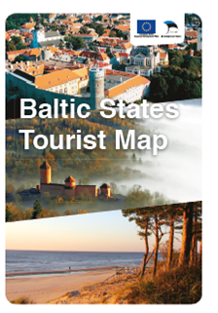
Cooperation between and
with Baltic countries
Markets with joint interest
Determing target client segments
Settling the marketing activities
Dividing responsibilities and costs
Agreeing on communication messages
Sharing and involving

Slide 8

Cooperation between
Baltic countries
Tourist fairs, presentations, workshops
and information days
in Europe and long haul markets:
Germany (ITB Berlin)
USA
Japan
China

Slide 9
Cooperation between
Baltic countries
Publications and e-marketing:
Baltic maps in Chinese, Japanese and American English
Baltic itineraries (camping maps and brochures) in English and German
Flash presentations in English and German
Press and FAM trips from long haul markets:
Journalists and tour operators visits from China, Japan and USA
Joint campaign for Baltic domestic tourism promotion:
Great Baltic Travel project (joint campaign for Baltic domestic tourism promotion)

Slide 10
Cooperation between Baltic countries
General cooperation:
Baltic Connecting international workshop for European tourism industry
EDEN (product development (specialized maps and itineraries), marketing activities, press trips etc., targeted at the German market)
Joint Baltic chapter on national tourism websites (unified content about all the three countries)
Cross-border product development (main roads, routes, roundtrips, etc. Involves product development) towards Europe and distant markets
Quarterly working meetings of Tourist Boards (3-4 times a year)
Preparation of the working programmes for periods of two years
Product development, educational study tours and information distribution within the Baltic states

Slide 11
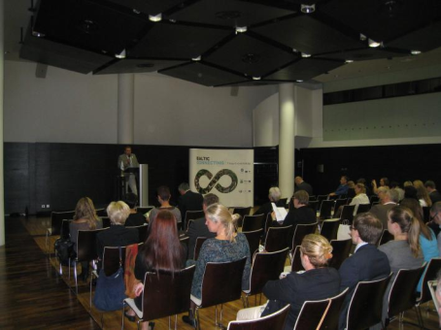
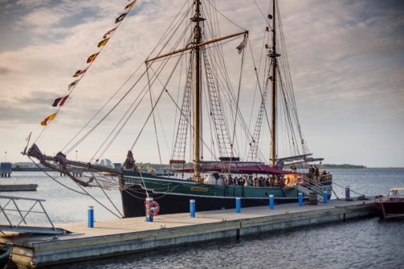
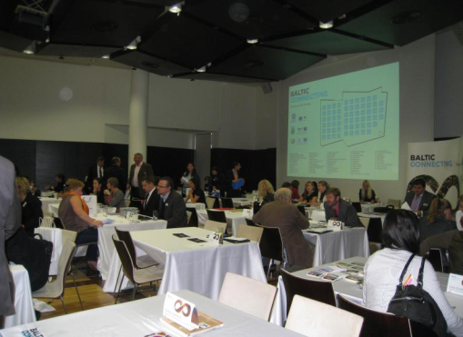
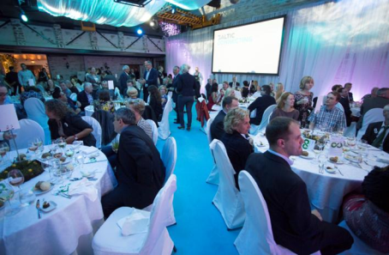
Baltic Connecting

