Slide 1

LONG-TERM
BALTIC TOURISM STRATEGY
Baltic Assembly
22.05.2015
Marina Paņkova
Secretary General
The Association of Latvian Travel Agents and Tour Operators, ALTA

Slide 2




The only professional public organization of travel agents and tour operators in Latvia.
Established in 1991.
Established by merger of leading tourism companies in order to found a consolidated managerial institution to coordinate and develop business activities of travel agents and tour operators, protect their interests and represent Latvian travel business on the world scale.
Today we are 70 companies.
Our members` market share forms up to 80% of all trade with tourism services in Latvia.

Slide 3
Member of ECCTA (2004) - the Group of national travel agents’ and tour operators’ associations within the EU. It actively cooperates with EU institutions and international organizations to ensure that their interests and special requirements are taken into consideration.
Cooperation partner to all national governmental bodies responsible for tourism development (Ministry of Economics, Ministry of Foreign Affairs, Ministry of Culture etc.), as well as regional institutions (municipalities).
Member of Consultative Committee to the Latvian Tourism Development Agency, responsible for realization of national tourism marketing.
One of the 4 founders of the foundation Riga Tourism Development Bureau (2009) together with Riga City Council, national airline airBaltic, the Latvian Hotel and Restaurant Association (LVRA).
Traditional & close cooperation partner with national air carrier airBaltic, other professional and regional tourism associations (AHRL, Country traveler etc.)

Slide 4

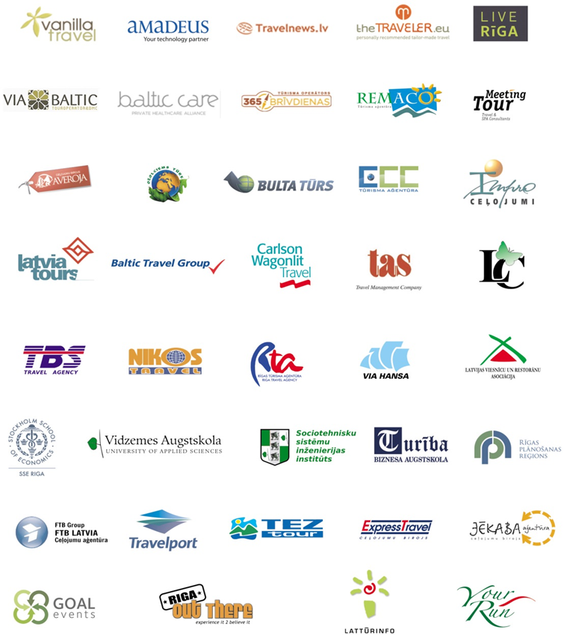

Sustainable Tourism
Cluster of Latvia
Overall goals:
To promote interdisciplinary collaboration among the travel agents and tour operators, tourism service providers, research and educational institutions thus facilitating the growth of sustainable tourism of Latvia and related company competitiveness
To create and implement innovations
To develop exportable tourism products
To provide optimum added value to clients and end consumers

Slide 5
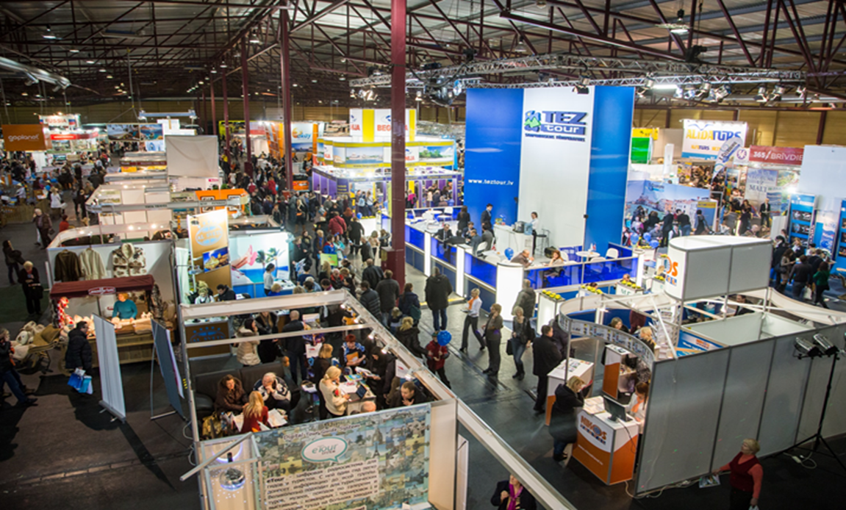
Cooperation between associations
Operational cooperation
Strategic collaboration
Scandinavian region
European level (package directive)
Balttour

Slide 6
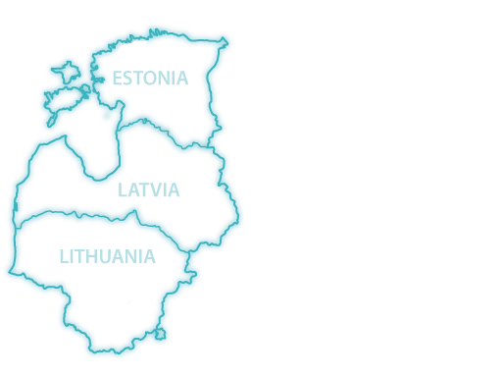


Members of ALTA: high quality, responsibility, professionalism
Products: the Baltics + Russia (Moscow, St Petersburg) or + Scandinavia (Stockholm, Copenhagen, Helsinki)
Culture + Nature + History // High quality expectations + value for money // Specific requirements

Slide 7
VIA HANSA
Via Hansa - tour operator, destination management company, hospitality service provider and lifestyle company in a vast geographical area stretching from Scandinavia over the Baltic countries and Russia to China.
www.viahansa.com - the first business-to-business travel service portal in the Baltic sea region, modern and comprehensive, interactive and dynamic, with daily up-dated detailed information about destinations and products, plenty of useful links to other databases and sources - an indispensable tool for any tour operator dealing with the Baltic Sea region.
Online booking systems - at the customers’ area at our web-portal allow you to book hotels, packages and other services directly from your own computer.
Flash-drives and apps with the most important product manuals - easy to use and very suitable for destination and product presentations.

Slide 8
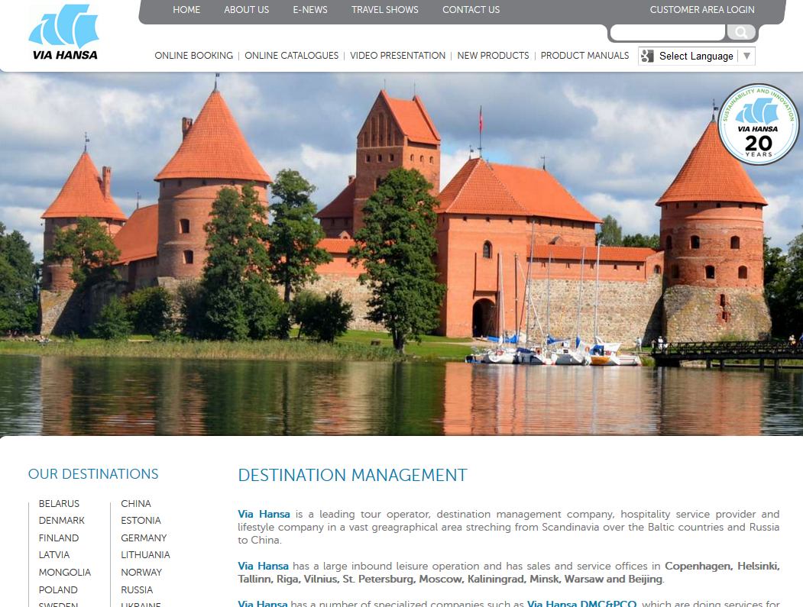
Hanseatic Lifestyle
During the last 2 decades the century old Hanseatic trading links of the Baltic Sea region has been re-established and the countries have been re-integrated the big family of Europe nations.
We are aware of our responsibility in this process and we are committed to history and mobility, to culture and intellect, to ecology and nature and to progress and social responsibility.
We are also committed to giving our customers the best the region has to offer with a comprehensive and sophisticated product, with professionalism and integrity and with innovation and style.
In medieval times a word between two Hanseatic tradesmen was a firm accord. Today we are still trading in the best of the Hanseatic traditions.
We are the modern Hanseatic trades people, who have added a touch of contemporary lifestyle to century old traditions.
https://www.youtube.com/watch?v=pC3NOvAD__4

Slide 9
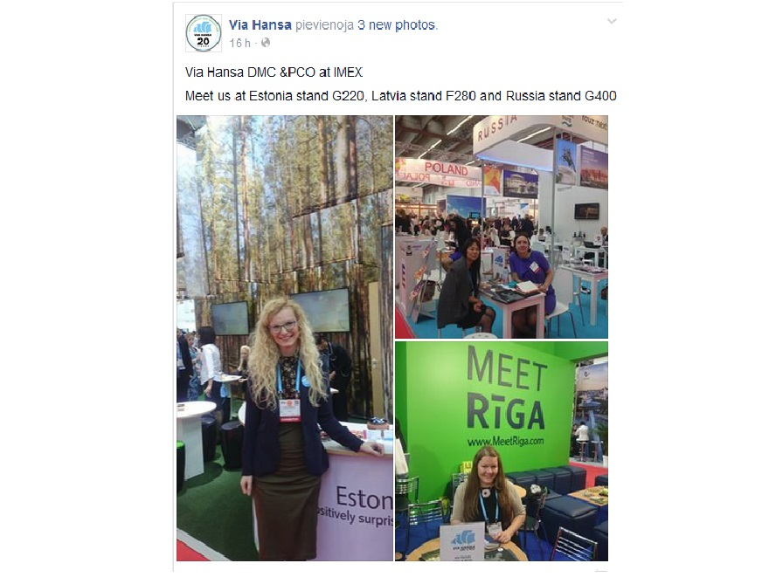

Slide 10
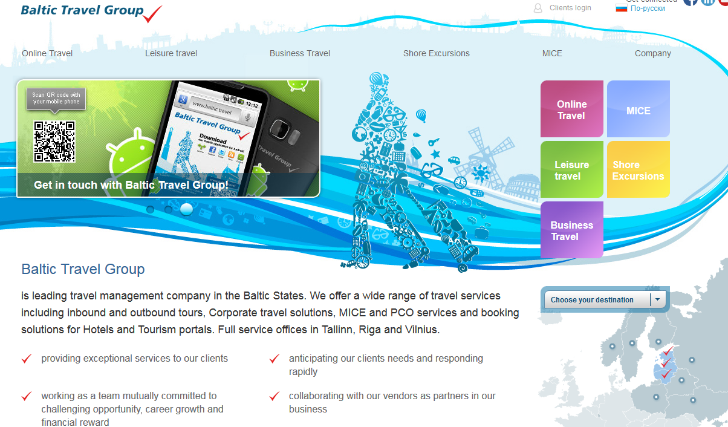
Baltic Travel Group

Slide 11
What is needed?
Accessibility (avio, auto)
Infrastructure (accomodation, MICE)
Marketing (nature)
Regional Tourism objects

Slide 12
To the fruitful cooperation in the future!
Thank you for the attention!
Contacts:
E-mail: alta@alta.net.lv
E-mail: marina@alta.net.lv
Web: www.alta.net.lv

