Slide 1
IMPACT OF FOOD IMPORTS BAN
BY RUSSIA
Jānis Volberts
Head of Foreign Investment Attraction, Tourism and Export Promotion Division
02.10.2015. Kaunas, Lithuania

Slide 2
The impact of the embargo on imports from Latvia to Russia
In the seven months of 2014 (before the introduction of an embargo) export of the goods within import embargo list amounted to 7.8% on the total share of Latvia’s export to Russia
According to the estimates, the total direct impact of the Russian embargo reach 0.25% of Latvia’s GDP (including 1.5% of the agriculture’s added value, 0.3% of the processing industry’s and 0.1% of the trade and transport services’)
Indirect influence related with economical slowdown in Russia and devaluation of rubble is more significant – 0,8% in first half of 2015
In the seven months of 2015 export to Russia decreased by 19,2% - 40% related to embargo list, 60% related to other goods
Notes:
Already from the beginning of the year 2014 the export volumes of goods included in the embargo list decreased, largely due to the worsening economic situation in Russia.

Slide 3
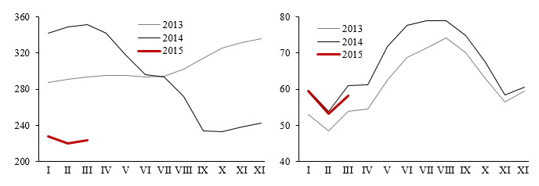
The impact on the milk sector in Latvia
Price (EUR/t) Volume (thousand t)

Slide 4
Export diversification of Latvia
By the groups of countries, %
By the groups of goods, %

Slide 5
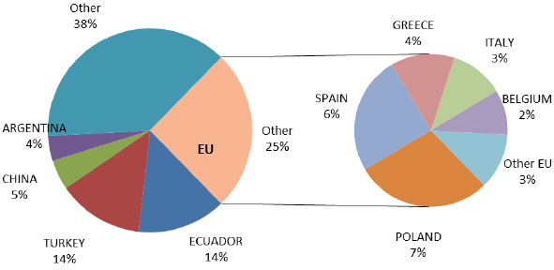
TOP 5 Russian fruit import origins and EU exporting MS
(2012-2013 average)

Slide 6
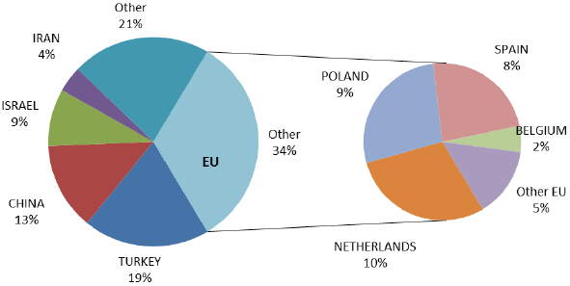
TOP 5 Russian vegetables import origins and EU exporting MS
(2012-2013 average)

Slide 7
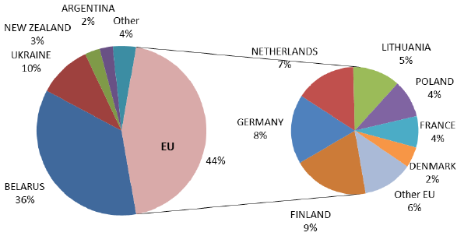
TOP 5 Russian dairy import origins and EU exporting MS
(2012-2013 average)

Slide 8
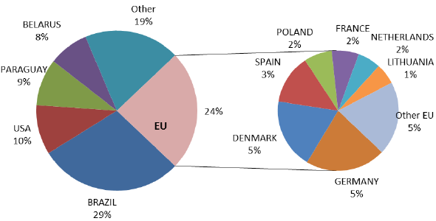
TOP 5 Russian meat origins and EU exporting MS
(2012-2013 average)

Slide 9
Proportion of goods affected by Russian embargo from the agricultural GDP (2013)

Slide 10
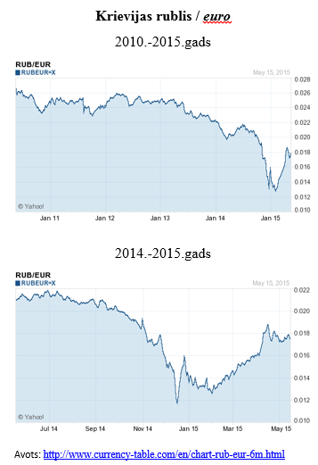
Depreciation of Russian ruble
Depreciation of Russian ruble
significantly affect also exports of goods and services not listed in embargo, including logistics and tourism industries

Slide 11
The main support measures
Amendments in regulations:
possibility to extend the taxation payment period
improvements in the customs regulations
Aid for agricultural primary producers and processors:
increased credit guarantees for farmers
emergency aid for the milk producers
Export market reorientation:
additional activities to the support program
increased the intensity of the aid

Slide 12
Additional activities in the export market development support program
Official representatives abroad
National stands at trade fairs
Trade missions
Marketing measures abroad
Visits by foreign companies
Transnational business forums
Export seminars
Advice on external markets
Business partner search

Slide 13
Thank you!
Ministry of Economics of the Republic of Latvia
Address: Brīvības iela 55, Rīga, LV-1519, Latvia
Phone: +371 67013100
Fax: +371 67280882
E-mail: pasts@em.gov.lv
Home page: www.em.gov.lv
Twitter: @EM_gov_lv, @siltinam
Youtube: http://www.youtube.com/ekonomikasministrija
Facebook: http://www.facebook.com/atbalstsuznemejiem

